Slide 1
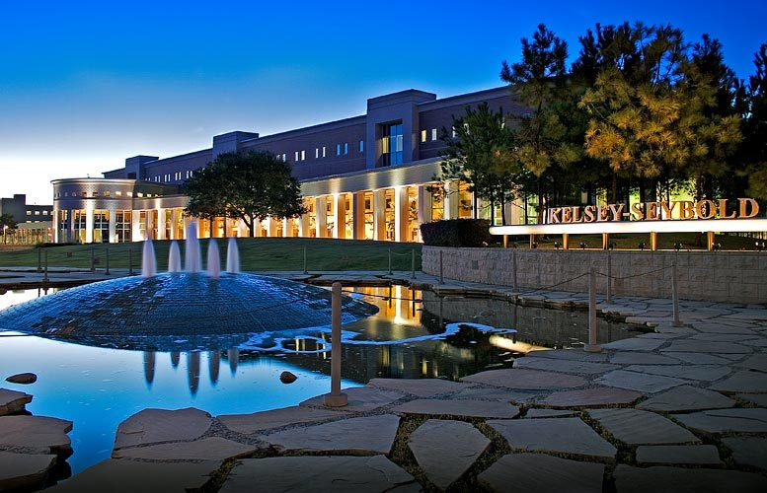
Kelsey-Seybold Clinic
Denise M. Jonathan, Pharm. D., R.Ph. – Director of Pharmacy

Slide 2
Agenda
1. Roles of a Managed Care Pharmacist
4. Questions
2. Kelsey Seybold Clinic Residency Program
3. Preparing for a Job in Managed Care

Slide 3
Health Plan
Roles of a Managed Care Pharmacist
Functions
Administer pharmacy benefits
Roles of a pharmacist
Direct patient care
Formulary management
Drug utilization review (DUR)
Benefit development and administration
Quality improvement
Drug information
Contracting
Logistics/operations

Slide 4
Pharmacist Job Opportunities
Roles of a Managed Care Pharmacist
Clinical Pharmacist
Pharmacy Director
Conducts Direct Patient Care
Medication Therapy Management Program
Hospital Discharge Program
Medication Reconciliation
Anticoagulation Services
Drug Utilization Review
Pharmacy Quality initiative
Adherence Program
Coverage Determinations

Slide 5
Pharmacist Job Opportunities
Roles of a Managed Care Pharmacist
Pharmacy Manager
Split between operational & clinical pharmacy activities
Clinical pharmacy program development, performance, enhancement and oversight
Formulary Management
Appeals & Grievances
Claims Oversight
Fraud Waste & Abuse
Medication Error Identification & Reduction
Healthcare Effectiveness Data and Information Set
Quality Improvement Programs
IT, BI, & Epic Consultant

Slide 6
Pharmacist Job Opportunities
Roles of a Managed Care Pharmacist
Clinical Pharmacist
Director of Pharmacy
Oversees health plan pharmacy administrative activities
PBM contracting and oversight
Request for proposals
Benefit design
CMS 5 star rating
Marketing and Member Services Consultant
Pharmacy financial performance
Pharmacy risk pools
CMS regulations

Slide 7
Agenda
1. Roles of a Managed Care Pharmacist
4. Questions
2. Kelsey Seybold Clinic Residency Program
3. Preparing for a Job in Managed Care

Slide 8
Managed Care Pharmacy Residency
Residencies expose pharmacists to the latest tools and techniques of managed care pharmacy
Post-graduate year 1 (PGY-1)
Post-graduate year 2 (PGY-2)
AMCP and ASHP accreditation
Currently in the state of Texas there are only 3PGY-1 Managed Care Residencies and 51 Nationwide
Kelsey-Seybold Clinic - Houston
CVS Caremark - Irving
Defense Health Agency Pharmacy Operations Division – San Antonio

Slide 9
Kelsey-Seybold Managed Care Residency
ASHP/AMCP Accredited PGY-1 Program
Program Highlights Formulary Management and Pharmacy Quality I Clinical Programs I (MTM, HDP, ADH, CPAS) Community Pharmacy, Drug Distribution, and Medication Safety Pharmacy Operations and Pharmacy Networks Formulary Management and Pharmacy Quality II Clinical Programs II (HPD, ADV MTM, and Reporting) Part D Clinical Consultant Prior Authorizations Appeals and Grievances

Slide 10
Kelsey-Seybold Managed Care Residency
ASHP/AMCP Accredited PGY-1 Program
Fringe Benefits Health, dental, & vision insurance 10 vacation/8 sick days Professional leave and travel reimbursement Application Process Participation in ASHP Match PhorCAS -Curriculum vitae -Letter of intent -Transcript -Letters of recommendation

Slide 11
Kelsey-Seybold Past Residents
ASHP/AMCP Accredited PGY-1 Program
Kelsey-Seybold Past MC Residents
Kelsey-Seybold Past MC Residents
2016-2017 Managed Care Pharmacy Resident
Tiffany Han, Pharm.D., R.Ph
University of Houston, College of Pharmacy
PBM – Health Plan Clinical Advisor
2015-2016 Managed Care Pharmacy Resident
Lin Guan, Pharm.D., R.Ph
University at Buffalo School of Pharmacy & Pharmaceutical Sciences
Health Plan Operational Pharmacist
2014-2015 Managed Care Pharmacy Resident
Rushil Patel, Pharm.D., R.Ph
University of Toledo College of Pharmacy
Health Plan Clinical Pharmacist
Caitlin Shorette, Pharm.D., R.Ph
Northeastern University College of Pharmacy
Health Plan Clinical Pharmacist
2013-2014 Managed Care Pharmacy Resident
Farzeen Khosravi, Pharm.D., R.Ph
Albany College of Pharmacy & Health Sciences
Health Plan Clinical Pharmacist
2012-2013 Managed Care Pharmacy Resident
Adrienne Roberts, Pharm. D. , R. Ph
College of Pharmacy, Xavier University of Louisiana
PBM Medicare Formulary Pharmacist
2011 – 2012 Managed Care Pharmacy Resident
Dominic T. Vu, Pharm.D., R.Ph. College of Pharmacy, University of Houston
Medicare Health Plan Clinical Pharmacist-MTM and Hospital Services
2010 – 2011 Managed Care Pharmacy Residents
Sejal V. Patel, Pharm.D., R.Ph. College of Pharmacy, Purdue University
Commercial Health Plan Clinical Pharmacist
Tracy Okolo, Pharm.D., R.Ph. College of Pharmacy, University of Nevada
PBM Pharmacist
2009 – 2010 Managed Care Pharmacy Resident Kirti Gandhi, Pharm.D., R.Ph. College of Pharmacy, University of Houston
Pharmacy Manager, Health Plan Services and Residency Coordinator

Slide 12
Agenda
1. Roles of a Managed Care Pharmacist
4. Questions
2. Kelsey Seybold Clinic Residency Program
3. Preparing for a Job in Managed Care

Slide 13
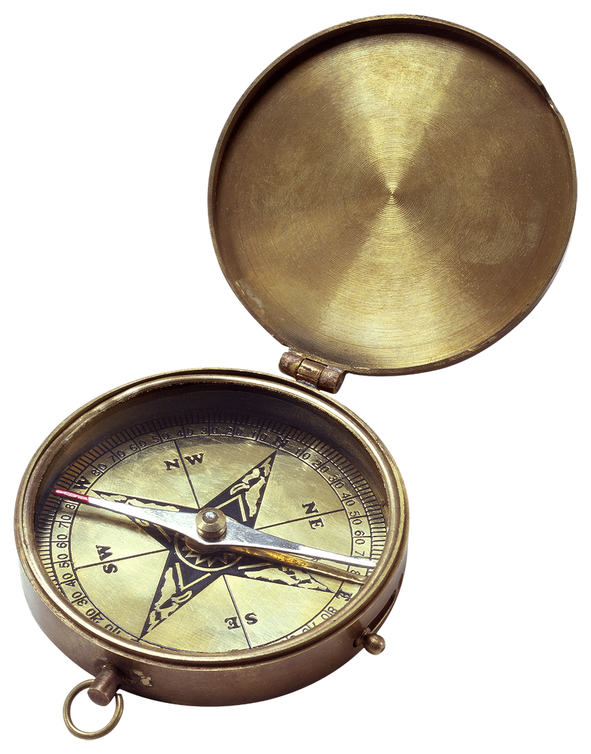
Experiential Training
Preparing for a Job in Managed Care
Student Pharmacist
1
Join a managed care organization such as AMCP
The best way to learn about managed care pharmacy is through an experiential training, an internship, or a residency program
2
APPE/IPPE Rotation or Internship
Pharmacist
1
PharmD or BS Pharmacy Degree
2
Residency or Fellowship
3
3-5 years Experience

Slide 14
Challenges in Current Position
Preparing for a Job in Managed Care
Current
Regulatory Changes
Changes in Quality (HEDIS, 5 star)
Past
Proving the Pharmacists Role

Slide 15
Job Satisfaction
Preparing for a Job in Managed Care
Make a Difference
Adherence
MTM
Cost Reductions
Impact Health Care in the Houston Area

Slide 16
Words of Advice
Preparing for a Job in Managed Care
Residency
Get involved
Networking

Slide 17
Questions?

