Slide 1
Managed Care Pharmacy
September 14th, 2017
Thomas Nguyen, PharmD, MBA
Notes:
To change the image on this slide, select the picture and delete it. Then click the Pictures icon in the placeholder to insert your own image.

Slide 2
Outline
Introduction to managed care
Pharmacist roles within managed care
Specialty pharmacy overview
Residency opportunities

Slide 3
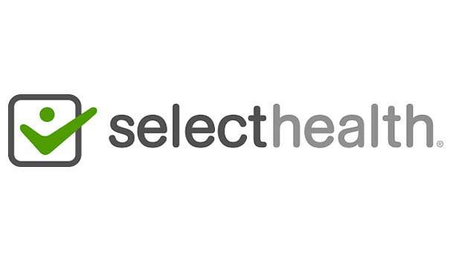
About Me
Oregon State University
BS General Science
Oregon State University/Oregon Health & Sciences University
PharmD
MBA
Pharmacy Work Experience
Intern at Pharmaca Integrative Pharmacy
PGY-1 Managed Care Resident at SelectHealth/Intermountain Healthcare in Salt Lake City, UT
Clinical Account Executive at Navitus Health Solutions
AMCP Co-diplomat at Texas Southern University
APPE Preceptor for UH COP & UT at Austin COP

Slide 4
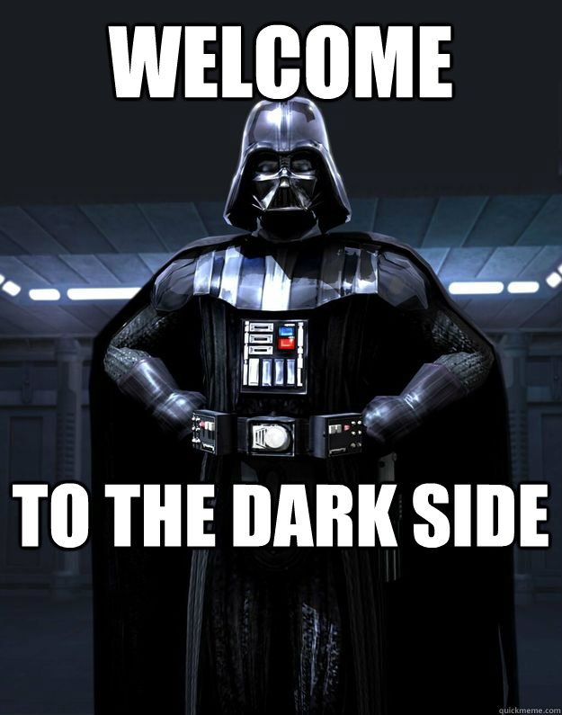
What is Managed Care?
Managed care pharmacy is the practice of developing and applying evidence-based medication to use strategies that enhance patient and population health outcomes while optimizing health care resources
Professionals in managed care pharmacy includes not only pharmacists, but also physicians and nurses
Additional information about managed care pharmacy can be found at: http://amcp.org/studentcenter/
Notes:
Insert welcome to the dark side figure here

Slide 5
Health Plans (a.k.a health insurance)

Slide 6
Pharmacy Benefit Managers (PBMs)

Slide 7
Health Plans vs. PBMs
Health Plan
PBM
Administers pharmacy benefit, oversees claims processing
Builds safety measures in claims system, Concurrent Drug Utilization Review (CDUR)
Negotiates drug and pharmacy contract rates to help control costs
P&T Committee creates formulary in combination with client
Assesses risk and supplies a variety of insurance plans to clients
Can offer medical, vision, life, dental, and pharmacy benefits
Collects premiums
Pays claims

Slide 9
Average day in managed care
Project management
Ensure compliance to state and federal regulations
Reporting of claims, processes, member/provider materials
Drug trending of utilization and spend
Limited direct patient interaction
Meetings (lots of different types of meetings)
Interact with pharmaceutical manufacturers
No two days are the same! …and its usually M-F (8-5)

Slide 10
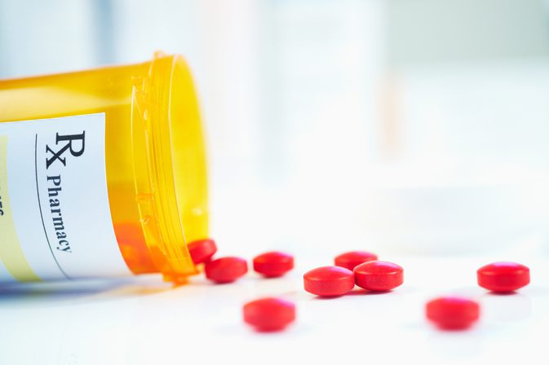
Pharmacist Roles in Managed Care
Traditional Managed Care Roles
Drug information
Formulary management
Utilization management
Data analysis
Clinical Programs
Prior Authorization
Client Management/Account Management
Provider Services
Industry Relations
Government Programs
Consulting
Medication Therapy Management (MTMs)
Pharmaceutical Industry
Outcomes research pharmacist
Consulting
Medical Science Liaison

Slide 11
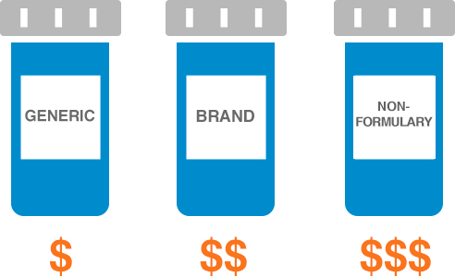
Formulary Management
What is a formulary?
A list of prescription medications that have been evaluated by a Pharmacy and Therapeutics (P&T) Committee made up of physicians, nurses, and pharmacists to offer the greatest value both clinically and financially to patients
Why do we have a formulary?
Formularies are created to try and control medication costs while providing the best care for patients
Medications are typically grouped into tiers based on their cost and clinical efficacy

Slide 12
Utilization Management
What is utilization management?
Encouraging safe, effective, and economical medication use
What are tools guiding utilization management?
Step therapy
Quantity limits
Prior authorizations
Medical exceptions/exceptions to coverage
Grievances and appeals

Slide 13
Client/Account Management
What is client management?
Proactive and consultative role in managing relationships with clients
What does this role entail?
Effectively communicate between the client and Navitus
Analyze financial and utilization data to identify opportunities for improving health care and controlling costs
Develop and implement clinical plans that meet clients’ goals
Manage formulary and clinical implementations

Slide 14
Industry Relations
What is industry relations?
Applying pharmacoeconomic and rebate contracting with manufacturers
Navitus’s goal is to strive for a lowest net-cost strategy
How does industry relations work?
Negotiate and contract with manufacturers for competitive rebates
Patent rebates
Post-patent rebates
Financial committee compliments strict guidance from P&T Committee
Navitus’ has a transparent business model which passes 100% of rebates to their clients

Slide 15
Prior Authorization
What does a PA pharmacist do?
Develop prior authorization criteria for a variety of drugs
Review submitted prior authorization forms from prescribers for approval/denial
Determine exception-to-coverage requests for approval/denial
Build electronic prior authorizations

Slide 16
Government Programs
What are government programs?
Address requirements set forth by Medicare and Medicaid in practicing pharmacy benefits management
What are examples of requirements?
Formularies are submitted, approved or denied a year prior
Prior authorization turnaround time
Inter-rater reliability
Overlap with clinical programs
STAR ratings

Slide 17
Consulting
What types of consulting gigs are there in pharmacy?
Employer benefits consultant
Government programs (e.g. Medicare) consultant
Market Access consultant
Research the landscape of therapeutics anywhere in the commercial cycle (Phase I to post-market) and potential asset acquisitions prior to market entry to develop a foundation of expected values and challenges that could affect the pricing and market access (PRMA) of a medication
Identify past therapeutics in similar situations (e.g. diseases, timelines, patient population) to further analyze potential outcomes for PRMA
Conduct interviews with payers to understand the value of novel therapies
Recommend strategies and clinical outcomes with varying levels of PRMA to help client prepare for launch

Slide 18
Pharmaceutical Industry
What does a medical science liaison (MSL) do?
Therapeutic area (e.g. oncology, cardiovascular)
Managed care (cross-therapeutic)
Provide clinical value, medical education and/or health economic outcomes information to payers, providers
Conduct clinical and outcomes research (real world, health outcomes) with clinicians and health plans
What does an outcomes research pharmacist do?
Budget impact modeling/incremental cost effectiveness ratio (ICER)
Conduct clinical and financial outcome research studies

Slide 19
Specialty Pharmacy
What is Specialty Pharmacy?
A pharmacy that specializes in dispensing “specialty” medications (high cost, drugs requiring extra monitoring before dispensing (ex: REMS), limited distribution drugs, etc)
How does a specialty pharmacy differ from a standard community pharmacy?
Usually cannot walk into these pharmacies, they act like a “mail order”
Dispenses only specialty medication
Dedicated pharmacists who specialize in specialty disease states and provides detailed counseling and follow-up with patients and providers
Unique reimbursement/payment methods

Slide 20
Residencies
Managed care residencies are usually Post-graduate Year 1 (PGY-1s)
Health plans, PBMs, or health systems (ex: Kaiser and VAs)
Diverse rotation offerings
Research project offerings/flexibility
Accreditation status (ASHP, AMCP accredited)
# of residents at each program (typically 1 per program, 2 at most)
Resident retention rate or what have past residents moved on to doing after completing residency

Slide 21
Tips for getting a managed care residency or pharmaceutical fellowship
Gain leadership experience
Select a managed care APPE rotation or pharmaceutical industry rotation (Navitus offers APPE rotation at our Austin and Madison, WI campuses)
Select a managed care rotation date prior to residency applications are due (managed care may not be for you)
Attend at least one AMCP conference as a student
AMCP Annual (Spring)
AMCP Nexus (Fall)
Residency showcase solely for managed care residencies
Dallas/Fort Worth - October 16-19th, 2017
SW AMCP Affiliate Meeting October 18th, 6:30 – 7:30 pm
Participate in your college of pharmacy AMCP chapter
Participate in AMCP Student P&T Competition

Slide 22
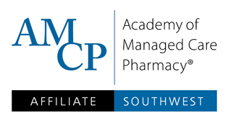
SW AMCP Affiliate CE Dinner
SW AMCP Affiliate Chapter will be hosting a CE Dinner in Houston Wednesday November 1, 2017
Topic TBD
# of students spots allotted for event registration TBD
Any interest?

Slide 23
Questions/Contact Information
Questions?
Email: thomas.nguyen@navitus.com
Office #: 512.231.3129

