Slide 1
What is Managed Care Pharmacy?
Developed by AMCP Membership Committee 2014-15

Slide 2
Managed care Pharmacy overview

Slide 3
Goals of Managed Care
Prevention of disease
Focus on wellness and enhanced quality of life
Improved clinical outcomes
Quality and accessibility of health care
Cost containment
Notes:
Goals differ from indemnity. Healthcare resources are not unlimited. Must have prudent use of available resources.

Slide 4
What is Managed Care Pharmacy?
Managed care pharmacy focuses on managing medication specific outcomes in a way that drives down the total cost of care and improves the overall wellbeing of the patient.
Managed care pharmacy organizations cover populations of people – pharmacists in managed care pharmacy have the ability to impact the care of millions of patients.

Slide 5
The Players in Managed Care Pharmacy
Notes:
Lot of players in managed care pharmacy – work together to reach the goals of managed care pharmacy

Slide 6
Managed Care Pharmacy Tools
Formulary development with P & T Committees
Medication Therapy Management
Prescription Drug Monitoring programs
Drug Utilization Review
Utilization management: prior authorizations, quantity limitations, and step therapy
Preferred & exclusive networks
Mail order pharmacy
Specialty pharmacy
www.amcp.org/mcptools
Notes:
Mention they can download tools brochure

Slide 7
Roles of pharmacists in managed care organizations

Slide 8
Pharmacists in Managed Care Pharmacy
Over 18,000 pharmacists working for health plans and pharmacy benefit management companies
Ensure the pharmacy benefit plan provides individual patients with medications that are:
Clinically appropriate
Cost-effective
Delivered through the appropriate channel

Slide 9
Drug Distribution and Dispensing
Pharmacists manage drug distribution process through four different approaches:
Community Pharmacies – MCOs contract with broad-based networks of participating pharmacies
Manage the pharmacy network
Perform drug utilization reviews (DUR)
Managed Care Organization Operated Pharmacies
In-house pharmacy owned by the managed care organization to provide enhanced pharmaceutical services

Slide 10
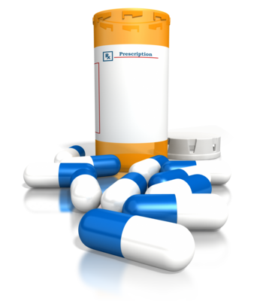
Drug Distribution and Dispensing
Mail Order and Online Services
Some Managed Care Organizations own or contract with mail order pharmacies
Manage services to ensure quality
Collaboration with physicians and other healthcare professionals
Work with prescribers to ensure the medications prescribed are:
Eligible for Coverage
Clinically Appropriate
Cost Effective

Slide 11
Patient Safety
Pharmacists help ensure patient safety by:
Analyzing prescription claims
Reviewing prescription use patterns
Educating prescribers about best practices

Slide 12
Patient Safety Programs/Tools
Drug Utilization Review (DUR) programs identify potential prescription-related problems
Drug/drug interactions
Duplication of therapy
Known allergies
Under- or overdosing
Potentially inappropriate therapy

Slide 13
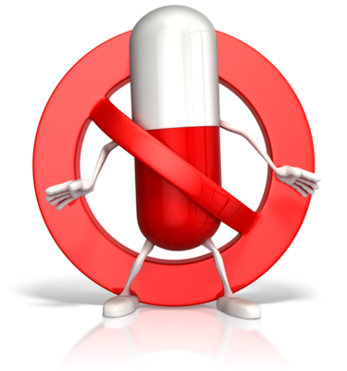
Patient Safety Program/Tools
Fraud and Abuse Programs
Review key drug classes
Monitor for patterns of inappropriate use
Prior Authorization (PA or “Prior Auth”) Programs
Approval process to encourage proper use of medications
Discourages inappropriate prescribing of medications

Slide 14
Patient Safety Programs/Tools
Monitoring Programs
Lab-based monitoring
Ensure medications are prescribed safely and used appropriately
Assess response to therapy
Monitor medication adherence
Screen for potential fraud, waste, and abuse
Promote optimal patient outcomes

Slide 15
Clinical Program Development
To enhance patient care, particularly for those with chronic conditions, pharmacists design clinical programs to:
Use evidence-based research data to create disease-management and medication therapy management programs
Encourage appropriate prescribing and proper use of medications
Promote use of cost effective therapies to benefit both patients and payers
Improve health and quality of life for population under their care

Slide 16
Communication with Patients, Prescribers, and Pharmacists
Pharmacists design and use communication protocols to facilitate exchange of necessary information:
Notify prescribers of drug safety alerts and prior authorization requirements
Educate patients on their disease state and medications
Provide pharmacies information regarding benefit parameters

Slide 17
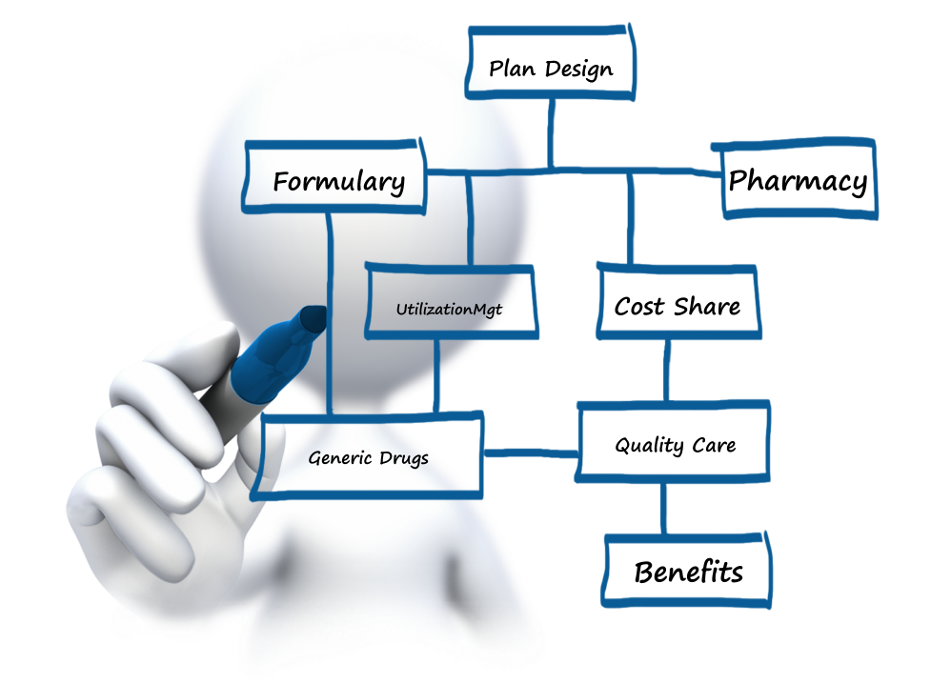
Plan Benefit Design
Pharmacists collaborate with other healthcare professionals to design effective benefit structures that serve a population’s needs:
Formulary
Plan Design
Pharmacy network
Utilization management
Patient cost share
Use of generic drugs

Slide 18
Business Management
Pharmacists contract with employer and health plan clients, pharmacies, and manufacturers to structure business arrangements that:
Allow their clients to customize clinical and reporting requirements
Negotiate with manufacturers for discounts on drug prices
Establish networks of pharmacies

Slide 19
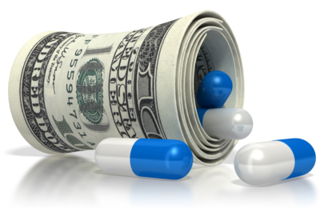
Cost Management
Pharmacists help their clients (employers, HMOs, trust funds, Medicaid, etc.) evaluate and improve their pharmacy benefit:
Encouraging providers to prescribe cost effective treatments
Integrating improvements with healthcare delivery
Introducing system interventions
Using data to identify adherence and non-adherence
Ensuring a scientific evaluation of cost

